Slide 1
NBA Basketball Player Database Management System
Hongzhi Liu: Database Design and Implementation
Sikai Ni: JDBC and front-end programming

Slide 2
Introduction
Task
Design and implement a user-friendly database management system for review and modification
of game records.

Slide 3
Use cases
1. Query Teams
2. Query Team Season Statistics
3. Query Team Statistics A Game
4. Insert Team Statistics A Game
5. Update Team Statistics A Game
6. Delete Team Statistics A Game
7. Query Players
8. Query Player Season/Career Statistics
9. Query Player Statistics A Game
10. Insert Player Statistics A Game
11. Update Player Statistics A Game
12. Delete Player Statistics A Game

Slide 4
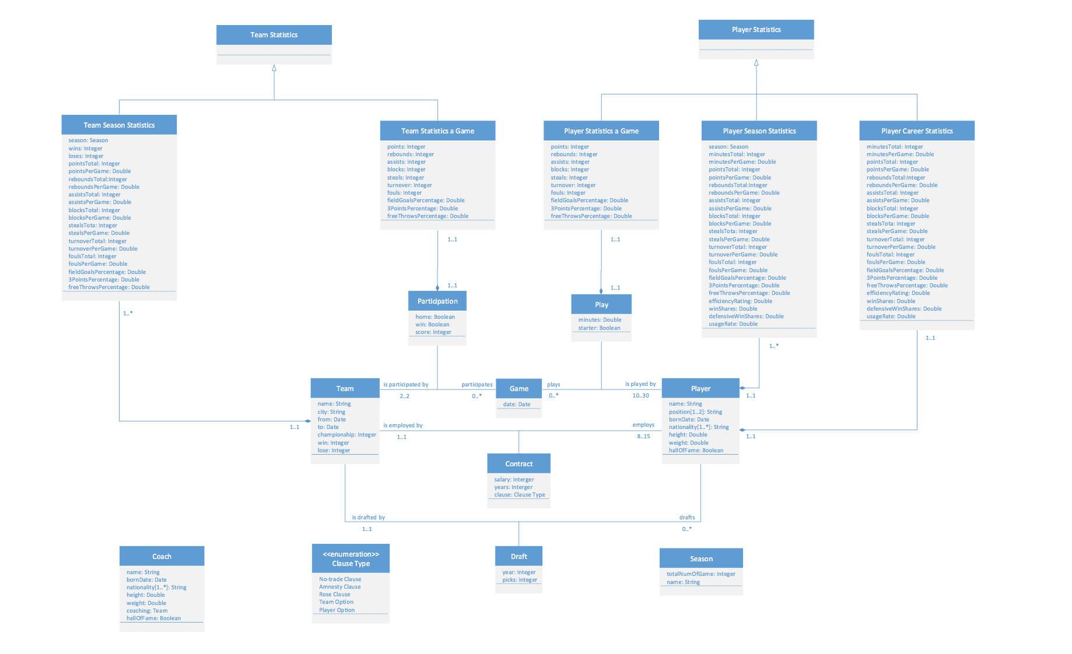
Design

Slide 5
Implementation
Layered Architecture
Spring IoC Container
Model-View-Controller (MVC)
JDBC in DAO-Layer

Slide 6
Implementation
Layered Architecture
The system is divided as view pages, controller layer, service layer, Data Access Object (DAO) layer, entity classes and database.
Guarantees a tightly-cohesion and loosely-coupling system property.

Slide 7
Implementation
Spring IoC Container
Create/wire/configure objects, manage complete life cycle.
@Autowired annotation gives Spring IoC container control right of objects.
Model-View-Controller (MVC)
DispatcherServlet dispatches requests to handlers.
@Controller and @RequestMapping maps requests to Controller handler methods.

Slide 8
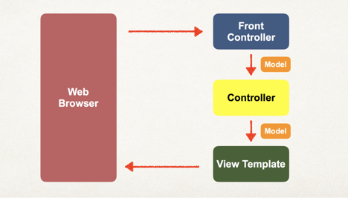
Implementation
View Template
9 front-end pages are designed and implemented to carry out the review and modification functionality
main-menu
teams-page
team-seasons
team-stats-aGame
team-from
team-players
player-seasons
player-stats-aGame
player-from

Slide 9
Discussion & Conclusion
A user-friendly database management system is designed and implemented.
Front-end operations are mapped into controller-layer methods with Spring/Spring MVC framework.
JDBC API connected the database system with user program.
layered architecture, Spring IoC Container, and Model-View-Controller (MVC) guaranteed encapsulation and loosely coupling.
Several queries are designed for Review, Insert, Update and Delete of game records, which fulfills the use case requirement.

Slide 10
Thanks!

